Slide 1
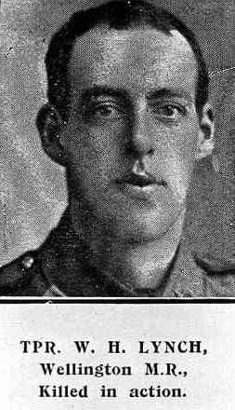
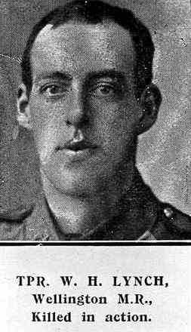
William Henry Lynch
11/71
By Matthew Batcheler

Slide 2
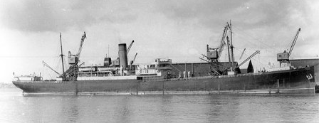
Background
William Henry Lynch was born in Wellington on the 27th of October 1895.
He enlisted into the army in 1914
He left New Zealand on the 16th of October 1914, onboard the Orari (HMNZT 6) to Sri Lanka then on to Egypt.

Slide 3
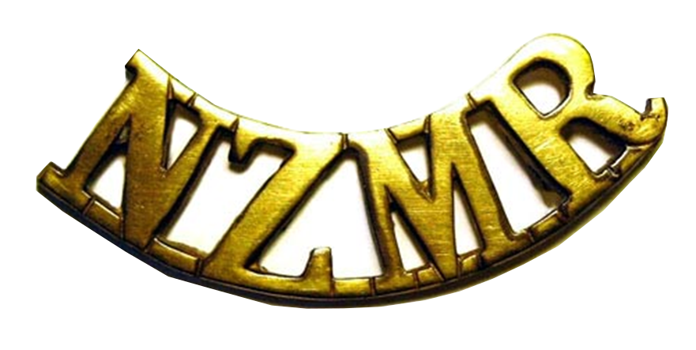
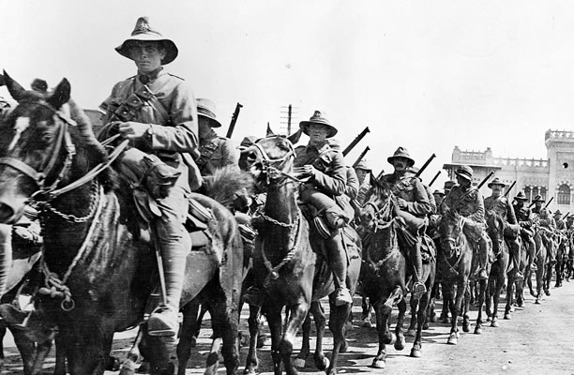
Mounted Rifles
Lynch was part of the Wellington Mounted Rifles
Unlike traditional cavalry, they rode into battle on horseback but dismounted before actually fighting.
They were joined by the Auckland, Canterbury and Otago mounted rifles, and rode in formation that reflected the four groups.
The regiment went to Gallipoli, where Lynch died, then on to the Sinai Peninsula and Palestine.

Slide 4
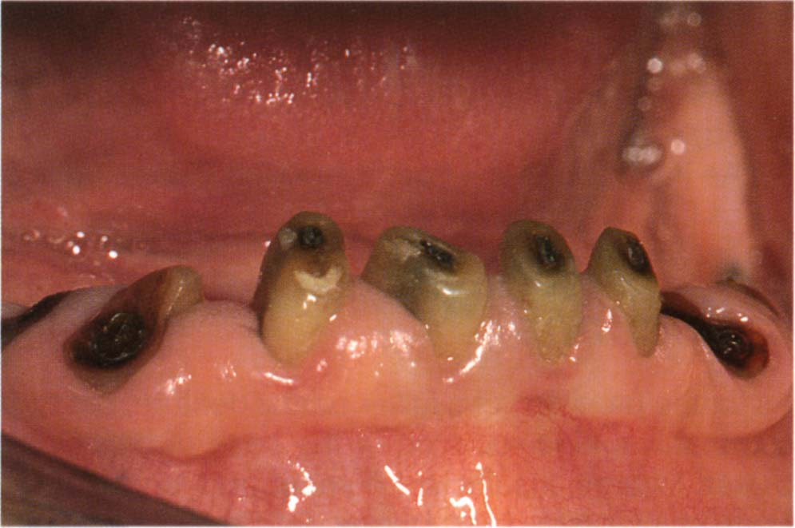
Dental issues
During his enlistment, his teeth were described as “Not good” by a medical officer.
On the 26th of November 1914 while on board the Orari, en route to Sri Lanka, Lynch saw a dentist.
According to military records, he had 28 teeth in stump condition which were extracted, and 4 lost.
Many aspiring soldiers were rejected for poor teeth, but William was allowed to stay because of his prior military experience.
He was given two dentures.

Slide 5
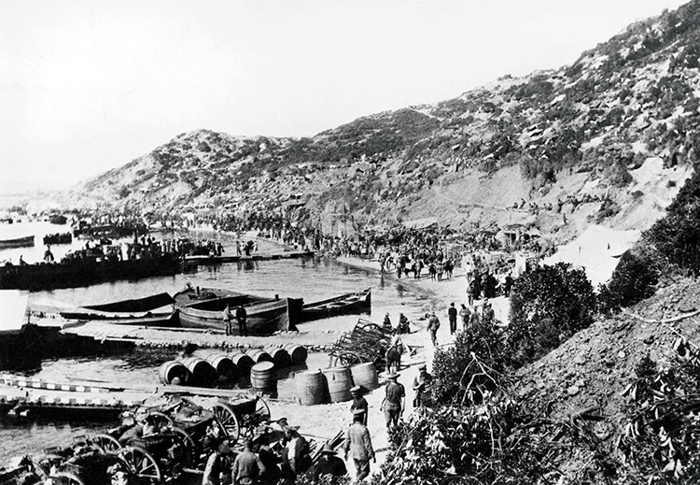
Gallipoli
In May 1915, after training in Egypt, the invasion of Gallipoli began.
On the 9th the mounted rifles departed on the ship the HMT Grantully Castle without their horses
They arrived off the coast of Gallipoli at 12:30am on the 12th.
They were loaded onto destroyers and the invasion commenced.

Slide 6
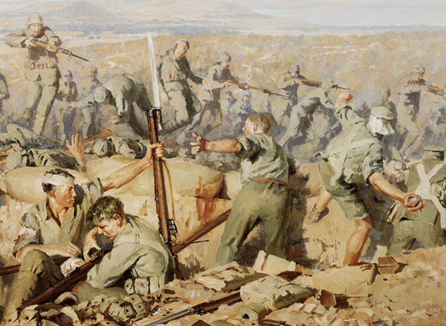
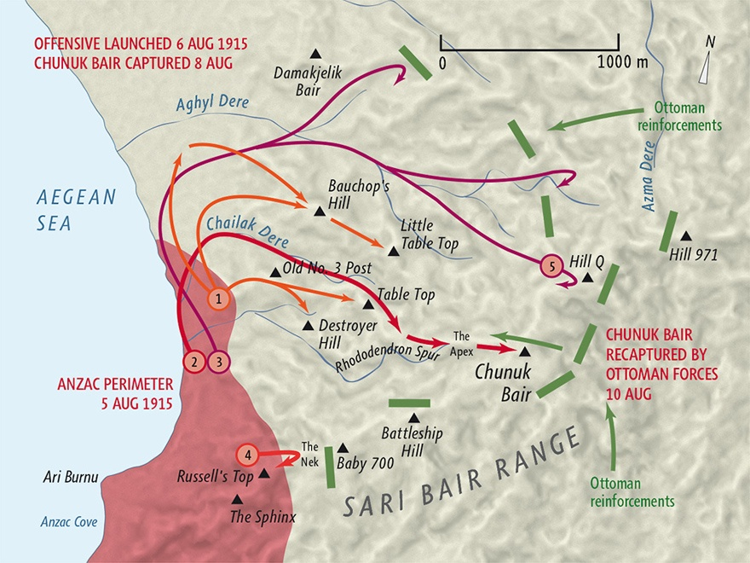
Death
On the 9th of August 1915 William Henry Lynch was killed in action at the Battle of Chunuk Bair.
Chunuk Bair was a peak on the Sari Bair mountain range and was one of the primary objectives for the initial Allied invasion.
At around 3:00 am on the 8th the Allied forces managed to take the hill after a Naval Bombardment.
However, the hill was very hard to entrench in and defend.
By 5am the Ottomans had launched a counterattack and by 5pm they had reclaimed the eastern side of the hill and had reinforcements.
By nightfall 711 out of 760 of the Wellingtonians to reach the summit had been killed or wounded. Lynch was killed while defending the hill.
On the morning of the 10th the Ottomans retook the hill by overwhelming force.
Notes:
The Wellington commander, William Malone, was killed around this time too

Slide 7
Personal connection – Andrew Lyon Divett Keen (46727)
My Great-Grandfather, Andrew Lyon Divett Keen, from Invercargill, was a carpenter who fought in WWI
He enlisted on the 9th of December 1916
He left for France on the 26th of October 1917
Got sick 8 times, including being admitted to hospital in Devonport
Was wounded 4 times
Wasn’t a hugely remarkable soldier, staying a Private all throughout the war but did manage to survive, something many did not manage.

Slide 8
My thoughts
During this research I was astounded at the many walks of life the people who served their country came from. There were teachers, cheesemakers, billiard-makers, master bricklayers, watchmakers, etc.
The amount of dead was also astounding. 93% of William Henry Lynch’s battalion who made it to the top of Chunuk Bair became casulties.
There was also an intense sense of desperation among the soldiers, recounted as “firing their rifles and those of their fallen companions until the wood of the stock was too hot to touch” while attempting to defend Chunuk Bair.

Slide 9
The End

Slide 10
http://ndhadeliver.natlib.govt.nz/delivery/DeliveryManagerServlet?dps_pid=IE11501156
http://ndhadeliver.natlib.govt.nz/delivery/DeliveryManagerServlet?dps_pid=IE18922520
http://www.aucklandmuseum.com/war-memorial/online-cenotaph/record/C9053?n=william%20henry%20lynch&ordinal=0&from=%2Fwar-memorial%2Fonline-cenotaph%2Fsearch
https://www.cwgc.org/find-war-dead/casualty/680137/lynch,-william-henry/
https://www.walkingwithananzac.co.nz/william-henry-lynch
https://nzhistory.govt.nz/war/wellington-mounted-rifles/1914
http://navymuseum.co.nz/worldwar1/ships/troopships-that-departed-new-zealand-during-world-war-one/
https://nzhistory.govt.nz/war/new-zealand-mounted-rifles
https://www.flotilla-australia.com/hmnzt.htm
https://en.wikipedia.org/wiki/Battle_of_Chunuk_Bair

