Slide 1
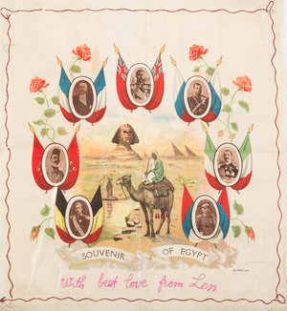
Len and The Egyptian Souvenir
The story of Leonard Truscott

Slide 2

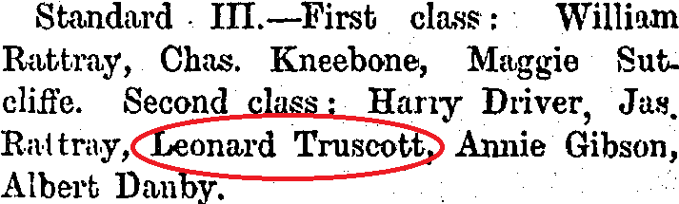
Leonard’s Origins
Leonard Truscott was born on the 28th of June, 1889 in Silverton, New South Wales in Australia.
In 1896 when Len was 11 or 12, he and his family moved from Australia to Thames, New Zealand. He and his siblings attended Kauaeranga Girls and Kauaeranga Boys. Those two schools along with Thames South School seemed to be the primary school in the area, and Thames South School is the only one of the three to still exist today.
By 1909, the Truscotts were living in Waihi and in 1915, Truscott was recruited in the military.
The attendance sheet for Kauaeranga Boys in 1900.

Slide 3

Leonard’s Family Tree
John Truscott
Mary Truscott
Jessie Isabel
William John Truscott
Thomas Arthur Taylor
Ivy Ellen
Truscott
Leonard
Truscott
Alice Jane Truscott
Marie Ray Foster
Reginald James Truscott
Note: I couldn’t find too much information about grandchildren

Slide 4

Len’s time as a miner
Len was born into a mining family, in which shifted locations throughout New Zealand to presumably follow the gold.
Leonard ended up living in Waihi before he went out to war, he and his father worked for Waihi Gold Mining Company (or Martha Mine)
Len and his father were both listed as strike breakers in the tragic Waihi miners strike, meaning they worked while others were on strike.

Slide 5
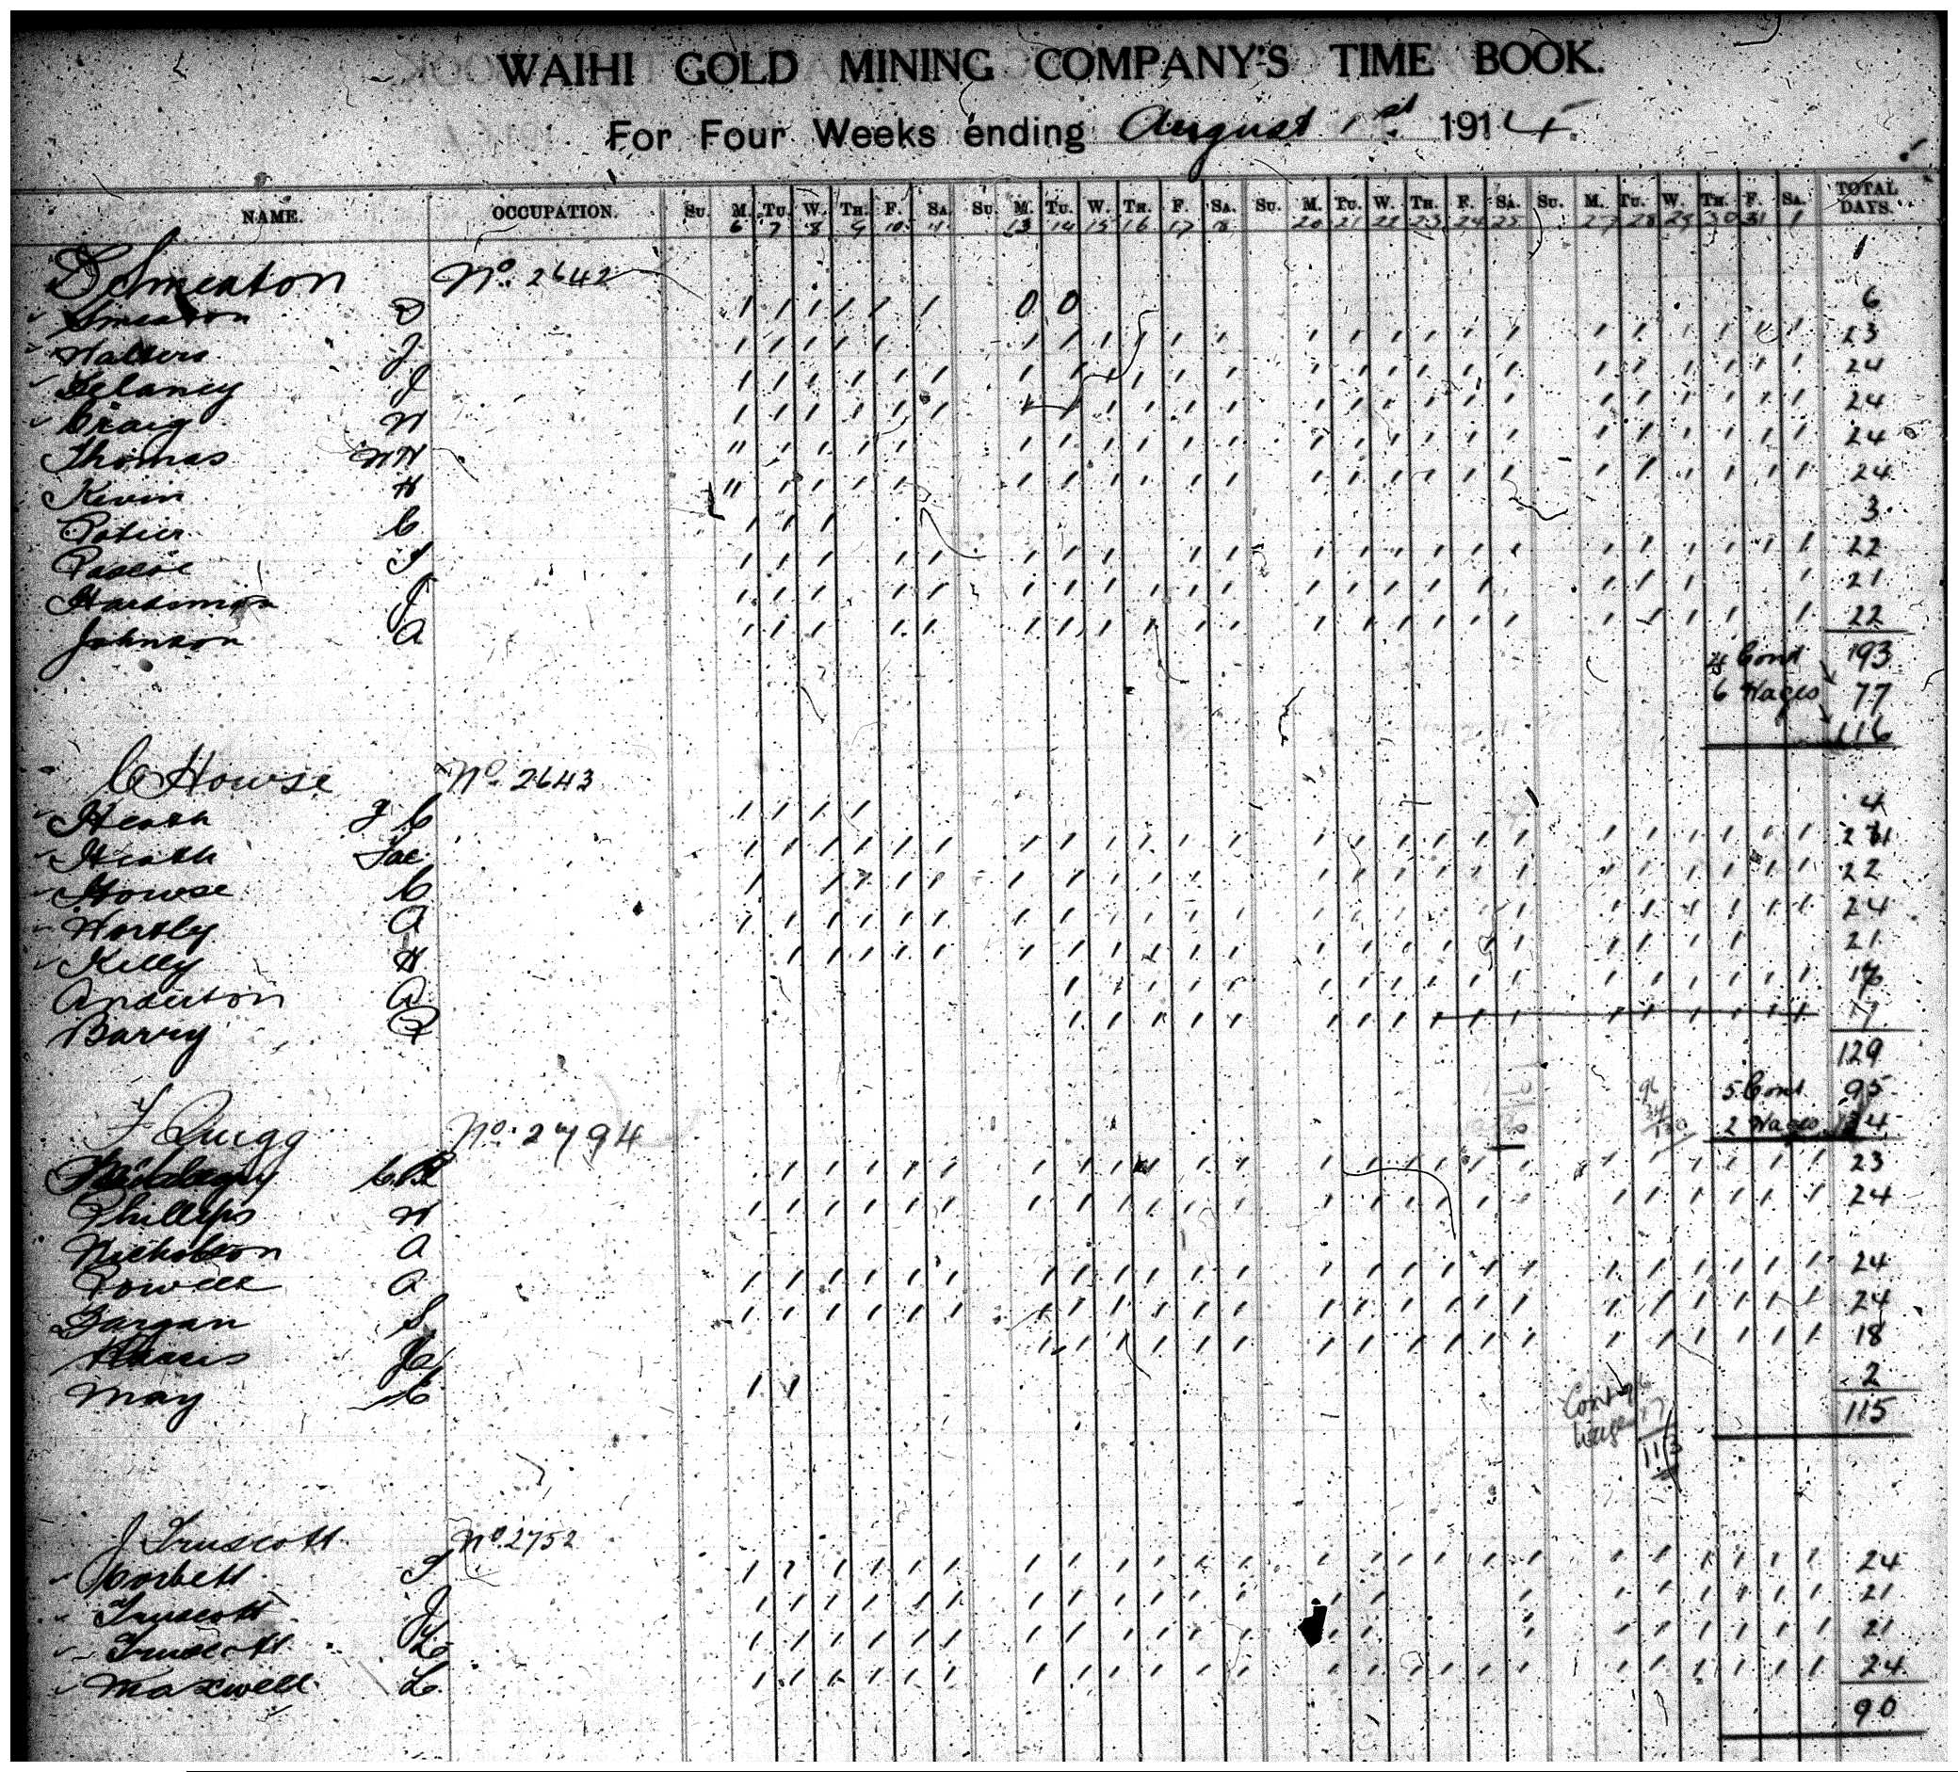
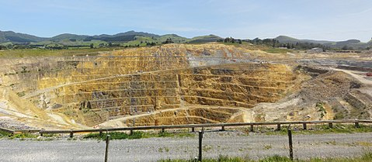

Len’s Time as a Miner part 2
Martha Mine, where Len and his father worked
A Waihi Gold Mining Co. time book with Len and his father’s names on it
Waihi Gold Mining Co (now known as Waihi Gold), is part of a larger company known as OceanaGold

Slide 6
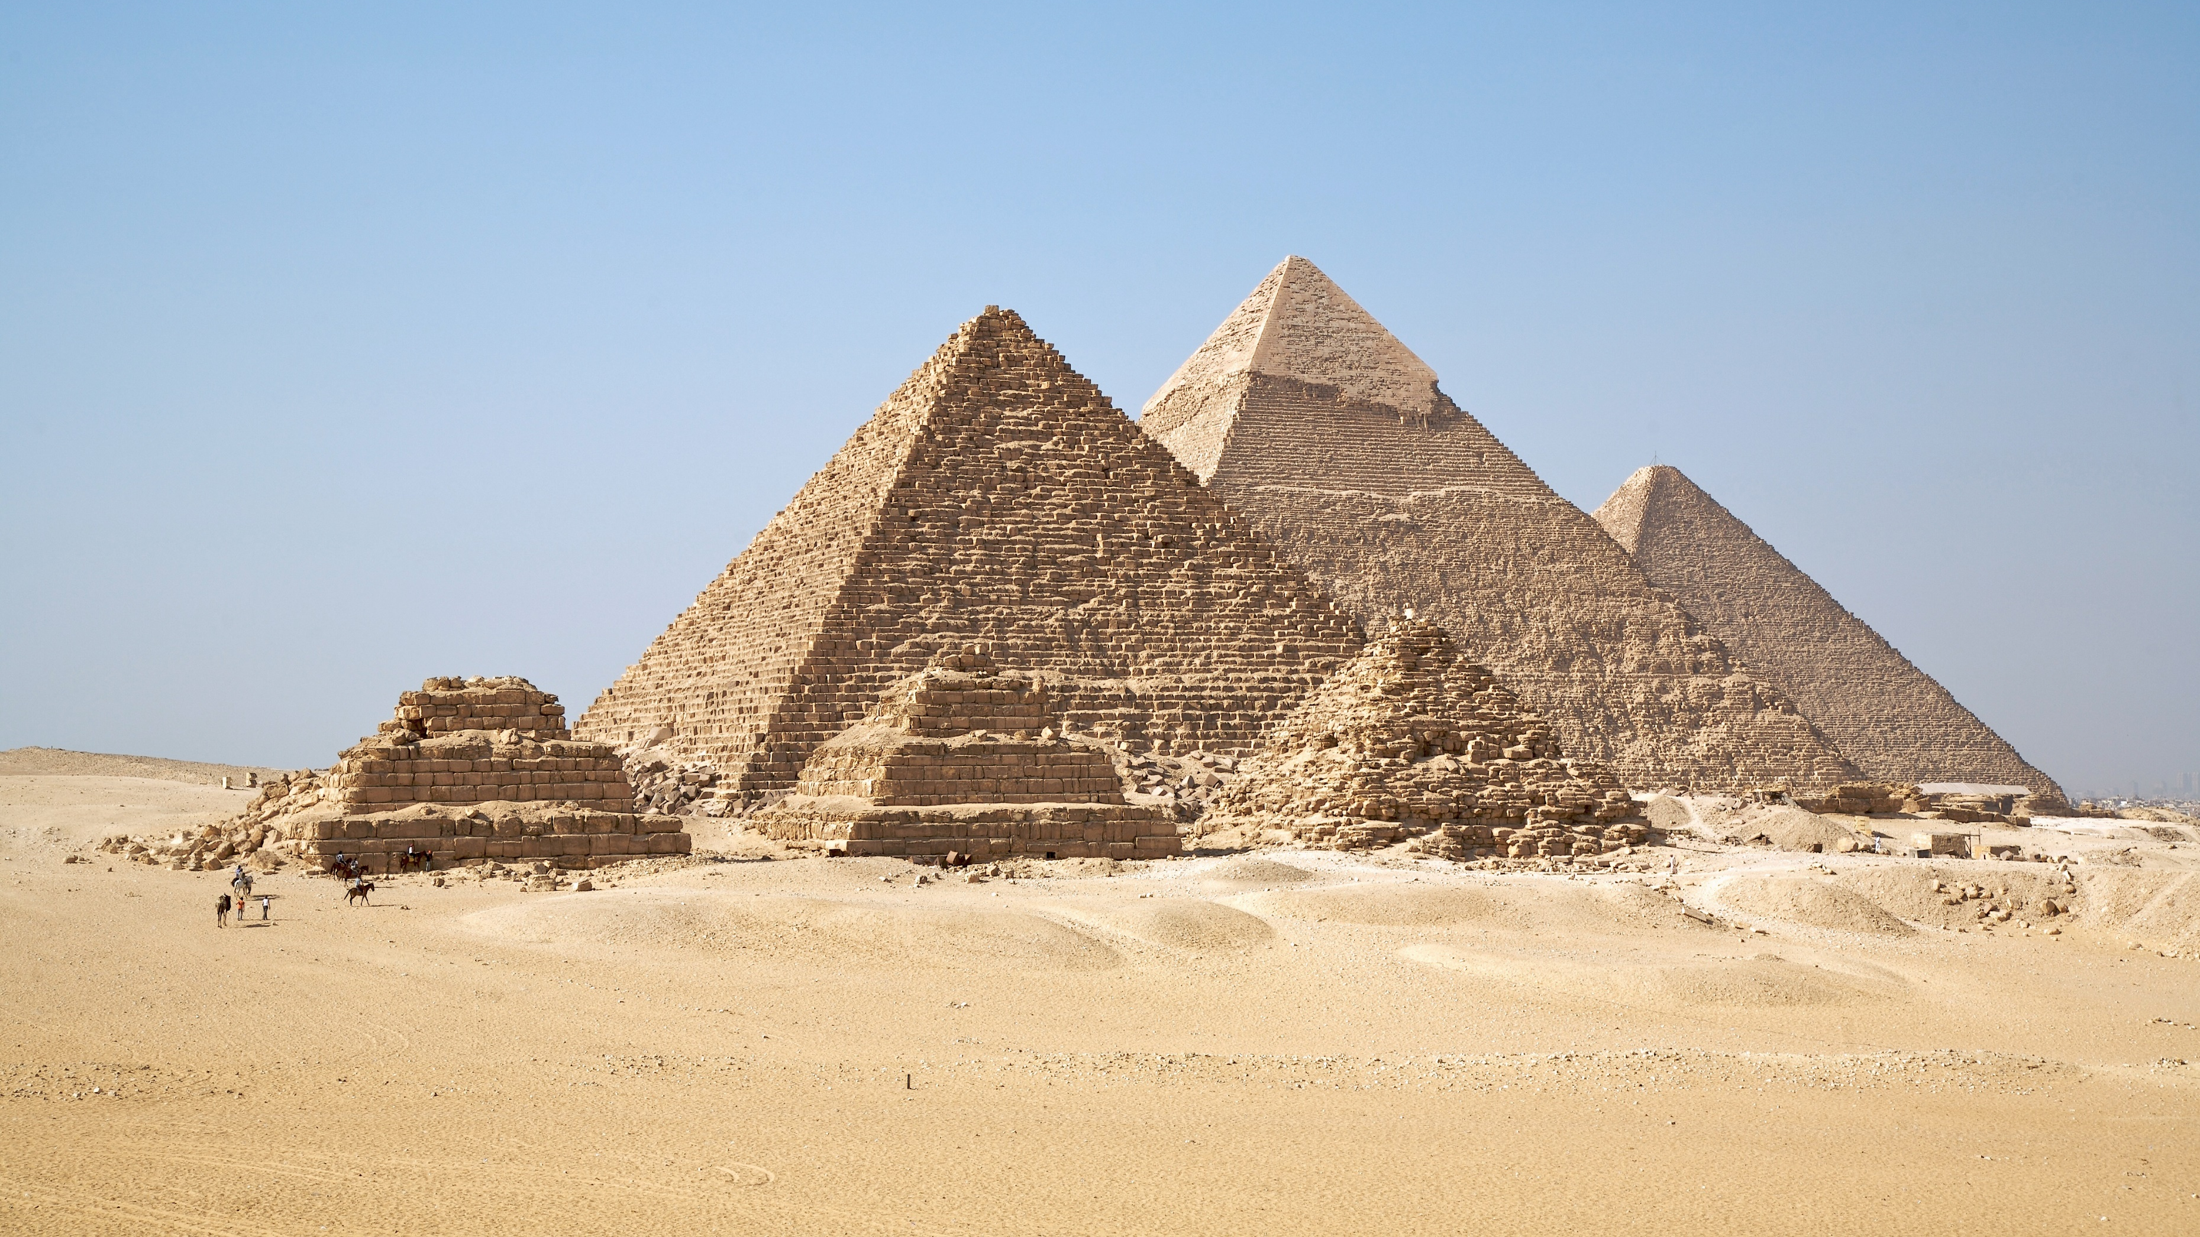
Service Information and the Souvenir
Leonard Truscott (3rd battalion) served in WW1 in the 3rd New Zealand Rifle Brigade and his service number was 23/307. Truscott embarked on the 9th October 1915 for Egypt.
The ANZAC troops were stationed in Egypt to train before they went to Gallipoli. This lead to many young soldiers to get to know the Egyptian people.
At the time Len purchased an Egyptian souvenir with all the Leaders of the major powers and a background of the Pyramids and the Sphynx.
Len decided that this souvenir should be sent to his family back in Waihi, and shortly after he followed through with it.

Slide 7
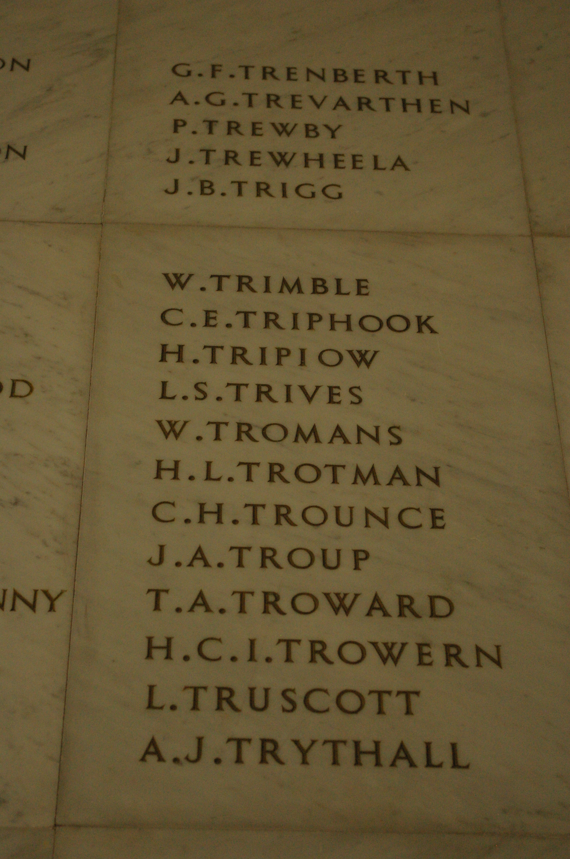
Service Information and the Souvenir PART 2
A photo of Len’s souvenir, at the bottom it shows a hand stitched message from Len to his family back in Waihi
Len’s name in the Auckland Museum

Slide 8

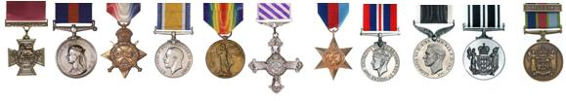
Last Wishes
Leonard left his last wishes in red on his history sheet, it is talking about where he wanted his money and medals to go. Len wanted his pay book/service record book to go to his mother Mary. He said he wanted his money and belongings to be left in the post office for his family and his medals to go to his next-of-kin (his mother).
Len afterwards changed his mind about his next-of-kin and said that it was his father as opposed to his mother.
Replicas of New Zealand military medals, possibly what Len’s medals looked like

Slide 9
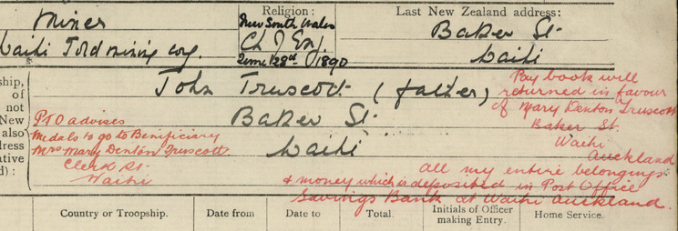
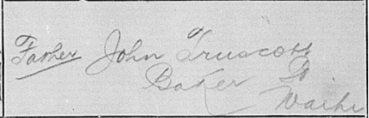
Last Wishes Part 2
Leonard’s last wishes before changed his mind
Len changing his mind and saying that his father is his next-of-kin, as opposed to his mother

Slide 10
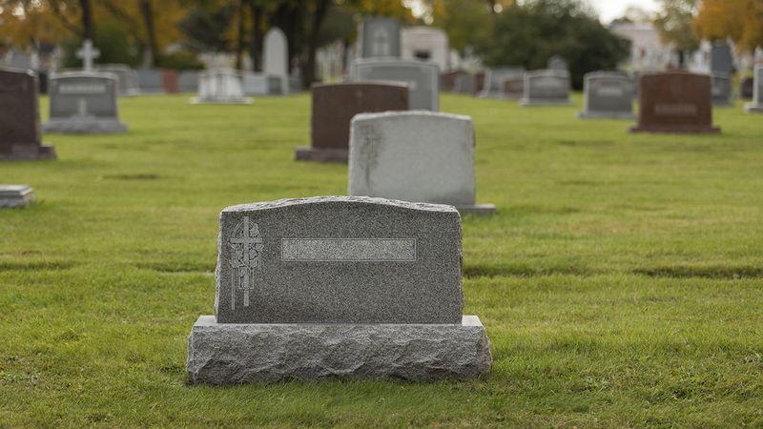
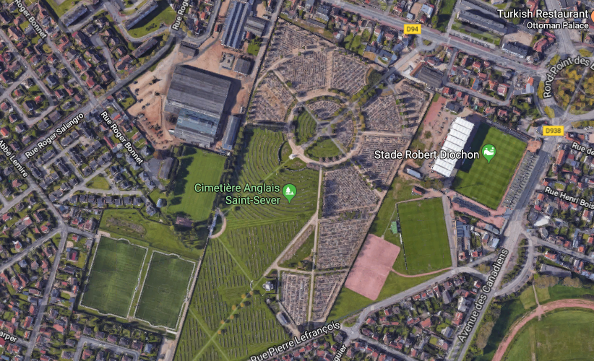
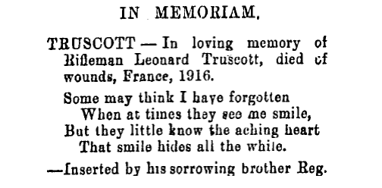
Leonard's death and Grave
Leonard was stationed in France when he was wounded on September 15th, 1916 and finally succumbed to his wounds and died at an age of 27 on December 9th, 1916.
Len’s grave is in France, in Saint Sever Cemetery, Rouen B.16.49.
A Google Maps picture of St Sever Cemetery
A message from Len’s brother Reginald James

Slide 11

My Response
Working on this allowed me to learn many new things about WW1, and it opened my eyes to the scale of the war. It personified the soldiers and really made me think about how each and every soldier has a family, a life and a story.
I think every student should learn about WW1 and how it affected the world.
I learnt many interesting things about Len, I learnt about the schools he and his siblings attended, I learnt about how he and his father were courageous to be strike-breakers in the Waihi miners strike.
Overall I am glad that I did this as it really allowed me to identify with our troops.

Slide 12

Bibliography
https://www.cwgc.org/find-war-dead/casualty/172684/truscott,-leonard/
http://www.waihimuseum.co.nz/museum-and-research/world-war-i/leonard-truscott/
http://www.waihigold.co.nz/
https://www.archway.archives.govt.nz/
http://www.aucklandmuseum.com/war-memorial/online-cenotaph/record/C15962

