Slide 1
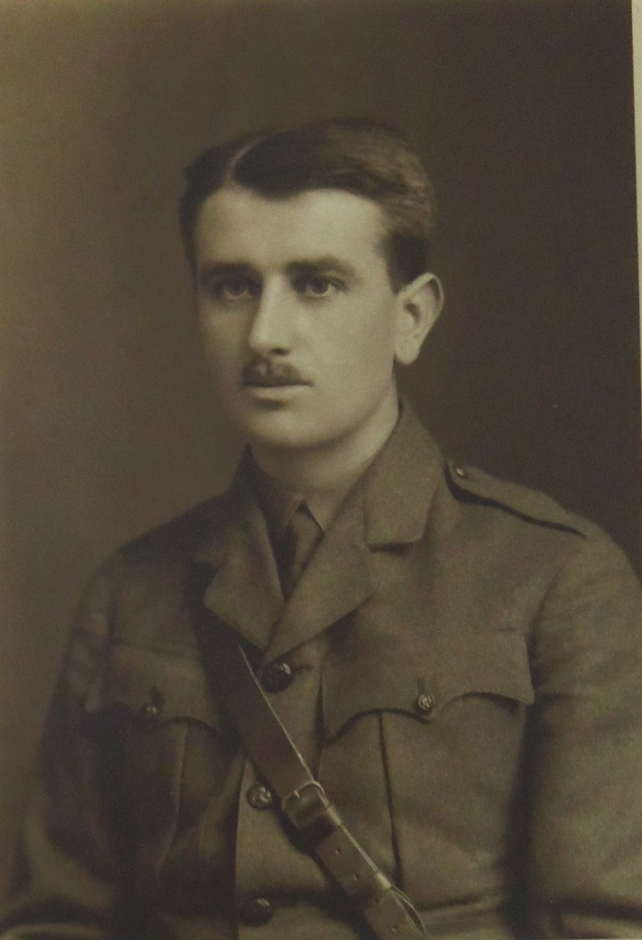
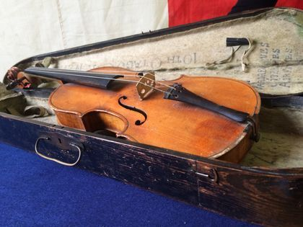
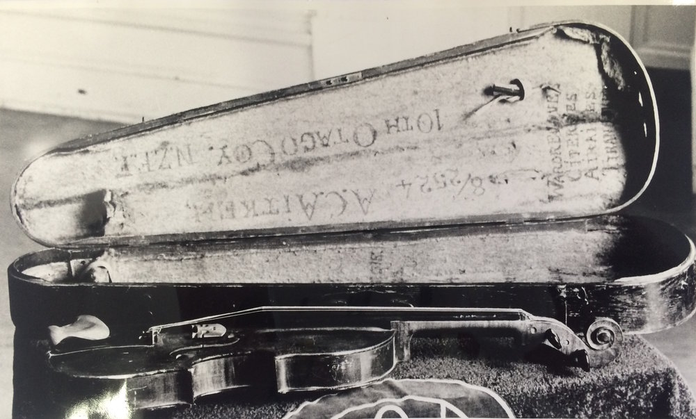
Alexander Craig Aitken
And his violin

Slide 2
References
Archives New Zealand
https://www.archway.archives.govt.nz
NZEDGE Legends
http://www.nzedge.com/legends/alexander-aitken/
Person Search
http://www.aucklandmuseum.com/war-memorial/online-cenotaph/search?p=2&w=World+War+I%2c+1914-1918&n=McRae
A C Aitken | Godfrey Thompson Project
http://libraryblogs.is.ed.ac.uk/godfreythomsonproject/tag/a-c-aitken/
Papers Past
https://paperspast.natlib.govt.nz
Kiwi Battlefields
https://books.google.co.nz/books?id=9CUZ5vYWkqsC&pg=PA52&lpg=PA52&dq=alexander+aitken+the+first+noel&source=bl&ots=Gk7459arH8&sig=OhIf-KDqtkdd0jhxq968AW-byoQ&hl=en&sa=X&ved=2ahUKEwiwx4mm0qnaAhUJXbwKHZvfC4QQ6AEwDXoECAQQAQ#v=onepage&q=alexander%20aitken%20the%20first%20noel&f=false
Alexander Aitken
https://www.walkingwithananzac.co.nz/alexander-craig-aitken/

Slide 3
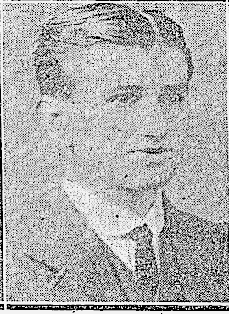
About Him

Slide 4
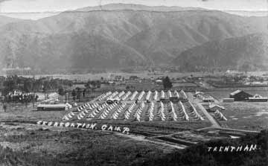
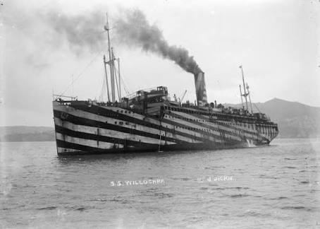
He was born on April 1st, 1895.
Attended Otago Boys High school and was part of their cadets programme for 4 years
Enlisted for the army in 1915 and joined the Otago Infantry Battalion
Service no. - 8/2524
Trained at Trentham military camp (just outside of Wellington) for 4 months before being shipped to Egypt on the troopships S.S. Willochra and Tofua
The Trentham Military Camp
The S.S. Willochra

Slide 5
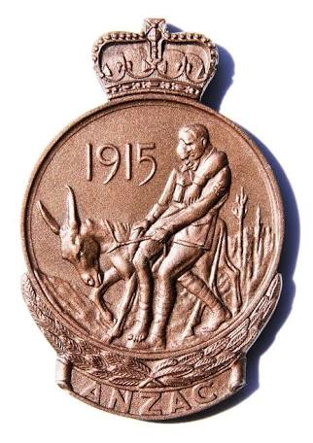
Served in Gallipoli, France and Egypt
Received the Gallipoli Medallion
Was injured in Somme on the 27th September, 1916 and discharged
His last rank was Lieutenant
After the war he returned to his job teach at a secondary school
Later he moved to Edinburgh to be a math professor at Edinburgh University
Died in Edinburgh in 1967
The Gallipoli Medallion

Slide 6
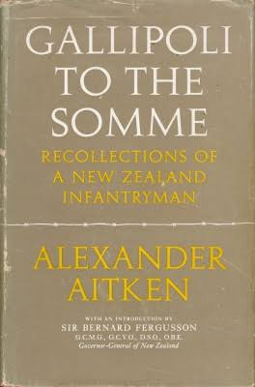
His Book
Just before he died he wrote a book detailing his story of the war
It is often thought to be one of the best depictions of conditions in Gallipoli and France
The book got Alexander elected as a Fellow of the Royal Society of Literature

Slide 7
Mathematical Genius

Slide 8
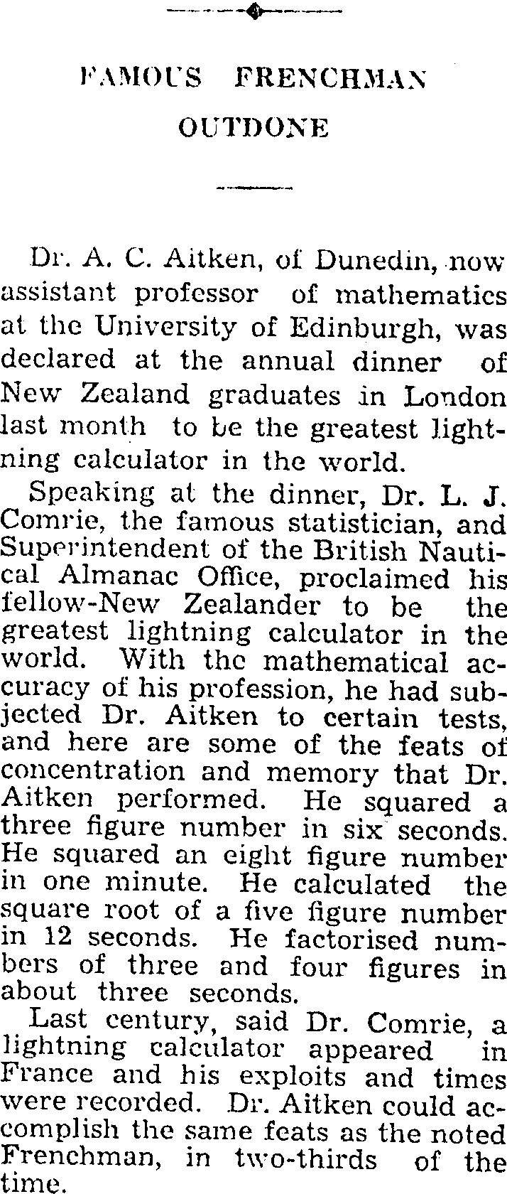
Alexander Aitken was known as the ‘Human Lightning Calculator’
He was known to have an incredible, even photographic memory
During the war he knew the name of every man in his company as well as their corresponding rifle number
In 1937 he was elected to the Fellowship of the Royal Society which is one of the greatest scientific and mathematical awards in the world
Newspaper articles regarding Alexander Aitken‘s successes

Slide 9
His Mathematical Feats
He took thirty seconds to multiply 987,654,321 by 123,456,789 and produce the correct answer: 121,932,631,112,635,269. Asked to render the fraction 4/47 as a decimal, he waited four seconds and answered: “Point 08510638297872340425531914 – and that’s as far as I can carry it.”
Squared three digit numbers in 6 seconds
Squared eight digit number in one minute
Calculated square root of five digit numbers in 12 seconds
Factorised three and four digit numbers in about three seconds
Could recite the first 98 digits of 1/97 without hesitation

Slide 10
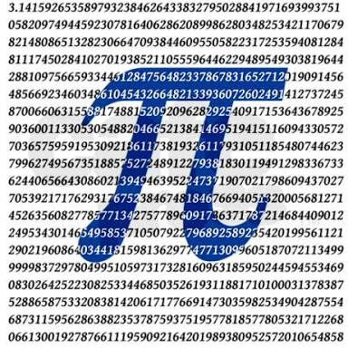
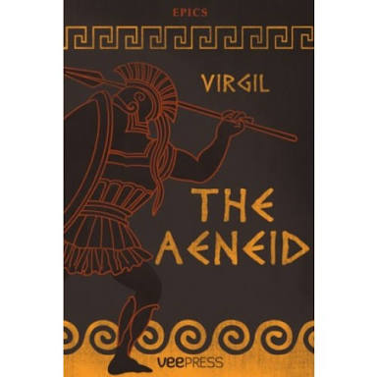
His ‘Photographic‘ Memory
He could recite the first 1000 digits of pi
He knew the Latin epic poem Aeneid off by heart (it has over 60,000 words)

Slide 11
How about you?
HEAD, GREEN, WATER, SING, DEAD LONG, SHIP, MAKE, WOMAN, FRIENDLY BAKE, ASK, COLD, STALK, DANCE VILLAGE, POND, SICK, PRIDE, BRING INK, ANGRY, NEEDLE, SWIM, GO
How many tries do you think you would need to memorise this list of 25 words

Slide 12
After being read the list of words at 1 second intervals Alexander took only 4 tries to read back the 25 words in order.

Slide 13
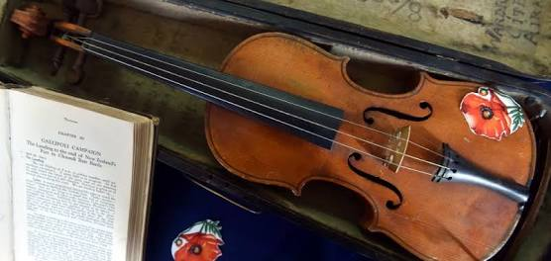
His Violin

Slide 14
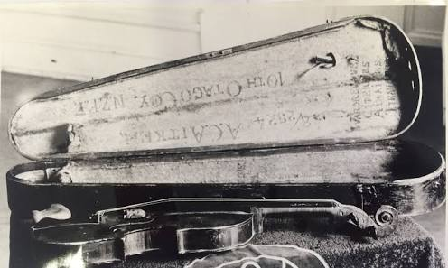
Alexander was given the violin by a friend who had won it in a raffle on a troopship on the way to Egypt
He played the violin nearly every night in Gallipoli and France and the music was cherished by his friends and companions
At times he felt like throwing the violin away because of how annoying it was to carry everywhere, however friends took turns carrying it for him
Friends also took turns hiding it from the authorities as it was deemed as contraband
When the violins E string broke he replaced it with a piece of telephone wire
These are pictures of the original violin

Slide 15
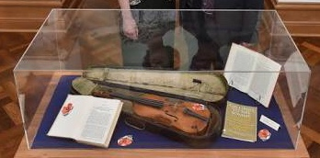
When Alexander was leaving Gallipoli he left the violin with the helper of an Australian major
He was on the island of Lemnos waiting for transport back to Egypt when the helper turned up at his tent
The major had told the helper to “chuck it in with his things“ because “Some fellows get attached to these things”
When he was injured in France he lost the violin however it was brought back to NZ and currently resides at Otago Boys High School

Slide 16
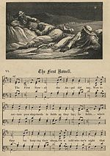
The most requested piece was ‘Humoresques’ by Antonin Dvorak. However as winter and Christmas approached ‘The First Noel‘ became more popular.

Slide 17
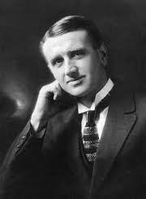
A Timeline of his life

Slide 18
April 1st 1895 - Born in Dunedin
1908 - Started attending Otago Boys High School
1912 - Gained first place in the nationwide University Scholarship Exam
1912 - Awarded Dux at Otago Boys High in his last year
1913 - Started studying at University of Otago
1915 - Enlisted in WW1
1916 - Injured in the Somme and discharged
1917 - Sent home after 3 months in hospital

Slide 19
1917 - Continues studying at University of Otago
1918 - Achieved first class honours in Latin and French and (surprisingly) second class honours in mathematics
1918 - Started teaching at Otago Boys High School
1923 - Gained a post-grad scholarship which took him to Edinburgh University
1923 - Studied for a PhD under Sir E T Whittaker
1924 - His PhD in smoothing data was considered outstanding and was awarded a D.Sc
1925 - Appointed to Edinburgh University - His first role was Lecturer in Statistics and Mathematical Economics

Slide 20
1932 - Co-authored ‘The theory of Canonical Matrices’
1936 - Became a Reader of Statistics
1936 - Elected to the Fellowship of the Royal Society
1939 - Wrote ‘Determinants and Matrices’ and ‘Statistical Mathematics’
1946 - Became Chair of Mathematics at Edinburgh University
1953 - Won the Royal Society of Edinburgh‘s renowned Gunning Victoria Jubilee Prize
1967 - Died in Edinburgh, Scotland

Slide 21
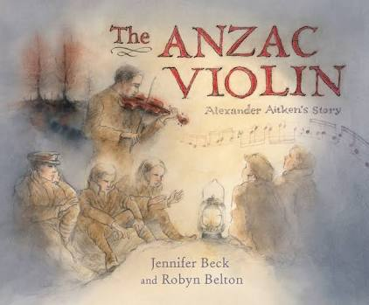
What has the violin inspired

Slide 22
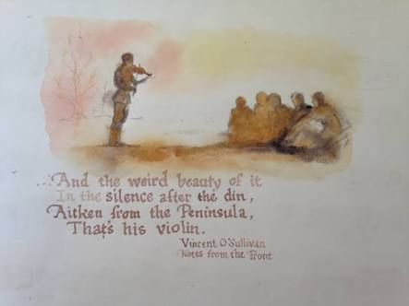
The Anzac Violin
This book is a picture book about Alexander Aitken and his violin

Slide 23
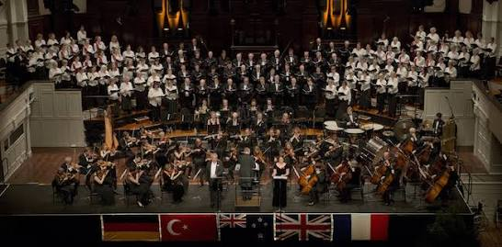
The Dunedin Orchestra
The Dunedin orchestra performed an oratorio titled Gallipoli to the Somme in 2016. The title of the piece is the same as the title of Alexander‘s book and is based on records from Alexander and other New Zealanders who served in the war.

Slide 24
Ernest Duncan McRae
My Great-Grandfather

Slide 25
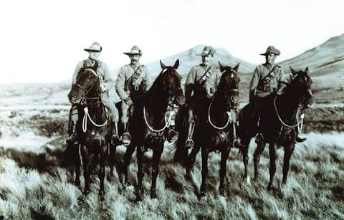
Born on the 27th of June, 1889
Ernest served in the Otago Mounted Rifles in WW1
In WW2 he was in charge of the Timaru home guard
His last rank was major

